Slide 1


1.Jakoko
2. Cola Jelly
3. Snowflake
Front
Hyunjoo
Rino
Heejae
Yonglong
Hyun Gee
Alice
Sienna
Jisun
Yeyoung
Naeun
Nanako
4. Rilakkuma
5. ING
6. TGIF
Yonghwan
Dahye
Youngeun
Sunny
Seungyeon
Hellena
Jimin
Ji Su
Jin
Soobin
Ye Jin
JooYun

Slide 2

Theme: Dating relationship
Narrative
writing
Week 5

Slide 3
Activities for Today
1. Pick a movie genre
2. Hire actors
3. Make an outline
( Break time)
4. Write a movie synopsis
5. Peer Revision
6. Award ceremony
( The End )

Slide 4
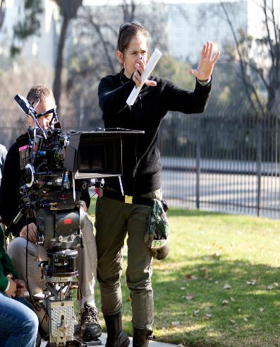
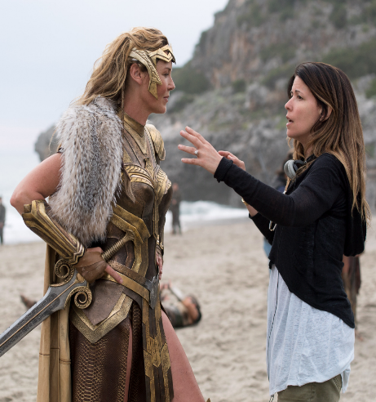
You got promoted from writer to
‘Movie director’

Slide 5
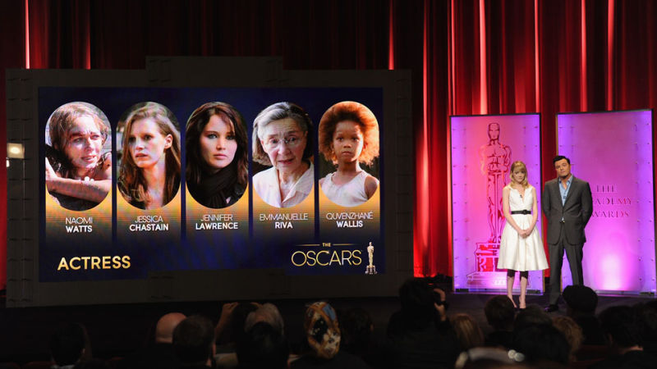
Your movie will be nominated at the ‘Academy Awards’

Slide 6
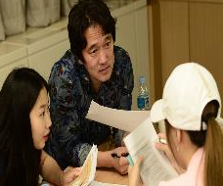
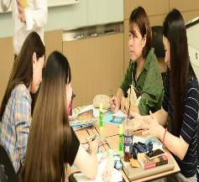
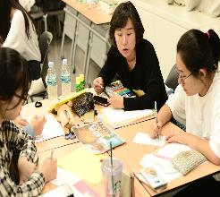

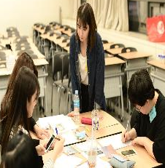
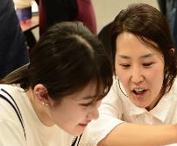
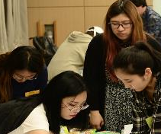
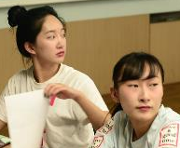
You should compete with other groups to win the ‘Oscar’
?

Slide 7

Task 1. Pick a movie genre
Pick a mission strip from the Magic Box
It tells you the special genre you will work on
Read example synopsis and discuss it

Slide 8
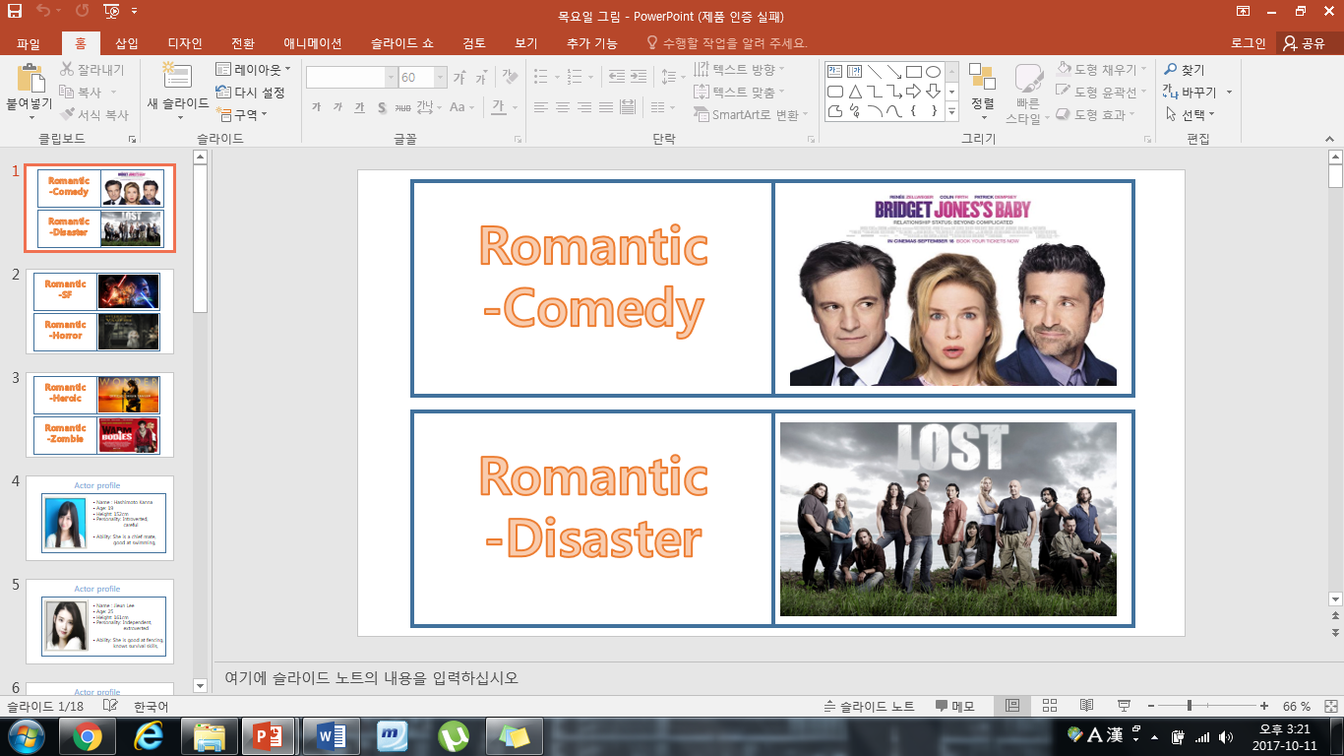
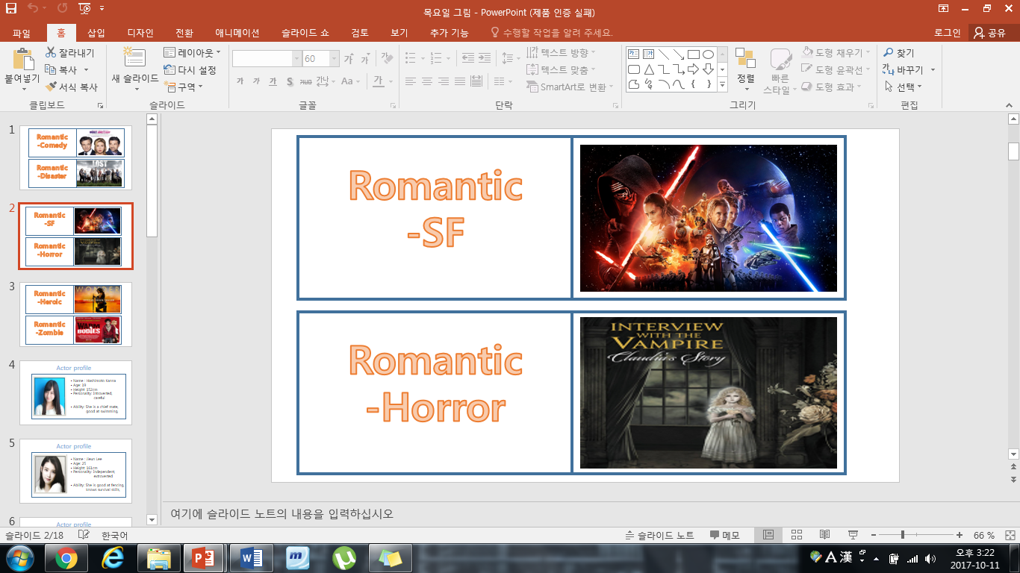
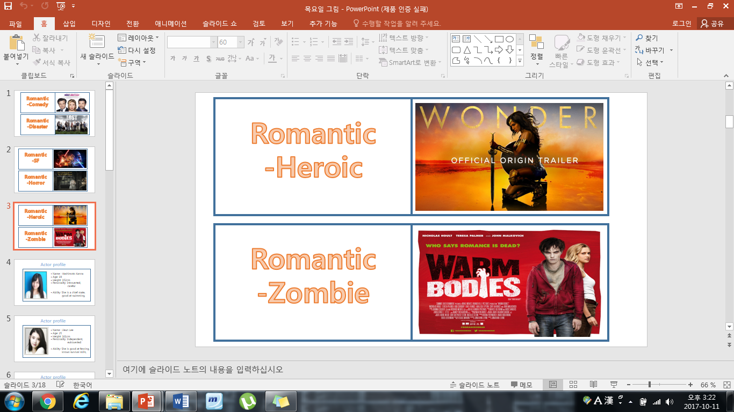

Slide 9

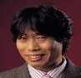





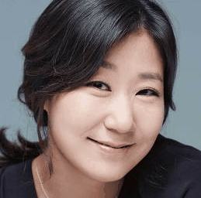
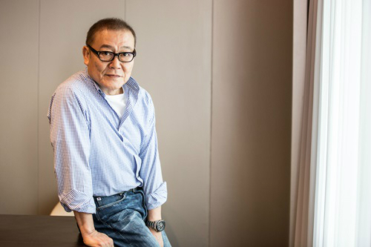





Task 2. Hire actors
You will be given actor profiles
Choose at least 4 main actors among them
Think of a main story and a theme

Slide 10
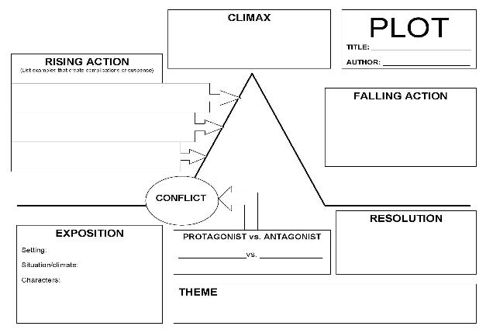
Task 3. Make an outline
Organize ideas on the ‘PLOT’ sheet
Compare with the example synopsis

Slide 11

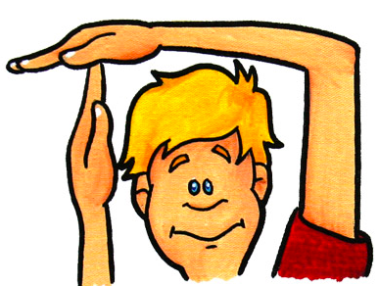

Slide 12
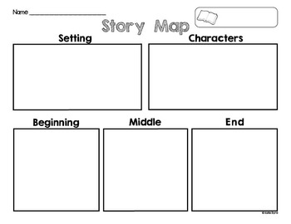
Task 4. Write a movie synopsis
Write the first draft
Take a self-assessment with the checklist

Slide 13

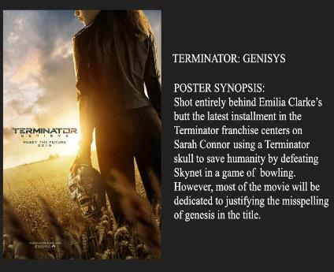
Task 4. Write a movie synopsis
Write a movie synopsis
Design your synopsis poster

Slide 14
Task 5. Peer Revision
Each group reads other synopses and writes a reader response

Slide 15
Task 6. Award ceremony
According to the scores of responses, we will decide the final winner !!!

Slide 16

Thank you very much
You did an excellent job

