Slide 1


TGIF
JakoKing
Jin
Soobin
Ye Jin
JooYun
Seungyeon Hyunjoo
Rino
Jimin
Ji Su
Colajelly
Younglong
Hyunjee
Heejae
Sienna
Rilakkuma
Snowflake
Yonghwan
Dahye
Youngeun
Nanako
Jisun
Yeyoung
Naeun
Alice

Slide 2

Persuasive writing
Week 13

Slide 3
Activities for Today
1. Scramble the essay
2. Brainstorming (language learning)
3. Plan an outline for the body
4. Write up the body
( Break time)
5. Peer revision
6. Write up the introduction and conclusion
7. Self-review and peer revision
( The End )

Slide 4
Task 1. Scramble the essay
Each group gets strips of the essay
Put the strips in the correct order
Paste the strips
Combine the number of each strip and
make a phone call to it
010 – ?? – ????? – ?

Slide 5

You are a very popular English linguist. You are about to contribute to a linguistic symposium.

Slide 6
Task 2. Brainstorming
Gather information for your way of learning a language (use your phone)
- Stay abroad / watch dramas or movies / read and listen a lot / make a relationship / study formally
Write down ideas in the worksheet
Find at least 3 important features
Ex) learning principle, the whole process, expected time to be fluent, convenience, …

Slide 7
Topics
Stay abroad (TGIF)
Watch dramas or movies (Rilakkuma)
Read and listen a lot (Colajelly)
Make a relationship with foreigners
(JakoKing)
Formal studying (Snow flake)

Slide 8

Task 3. Plan an outline
Each sister chooses one idea and
makes an outline individually
Make a topic sentence + 2~3 supports
The outline should be persuasive

Slide 9

Task 4. Write up the body
Each sister writes up a paragraph individually
Supporting details should be directly related with the topic sentence.
Paste the body on the essay paper

Slide 10

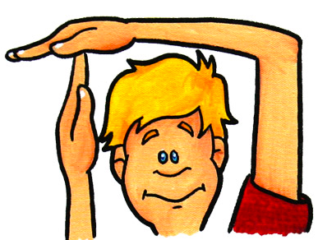

Slide 11

Task 5. Peer revision
Pass the body paragraphs clockwise
Evaluate it with a peer review sheet
and give it back
Read the review and revise the body

Slide 12
Task 6. Intro and conclusion
Each group writes up an intriguing introduction with a technique they learned
Ex) a question / story / interesting fact, …
Make a concrete thesis statement
In the conclusion, include the main ideas of the body
Check up with the self-review sheet
Paste the intro and conclusion

Slide 13

Task 7. Peer revision
Pass the essay clockwise
Evaluate it with a peer review sheet
and give it back
Read the review and revise the essay

Slide 14

Thank you very much
You did an excellent job

